Slide 1

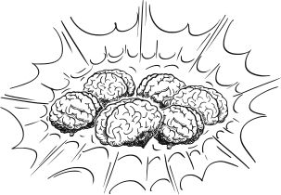
BRAIN
TUMOR
GitHub Repo
Classification & Object Detection
System
Page 01

Slide 2
TEAM
MEMBERS
Sarah Alaa
Menna Mahmoud
Abdullah Yasser
CNN Model From Scratch
Applied RESNET Versions
Applied Effiecent Versions
Nour Yahia
Ahmed Abo ELnaga
Amr Ibrahim
Applied Desnet Versions
Object Detection Model
Model Deployment
Page 02

Slide 3
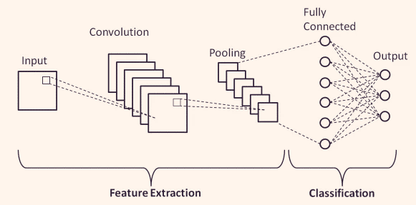


PROJECT
COMPONENTS
IMAGE
CLASSIFICATION
OBJECT
DETECTION
MODEL
DEPLOYMENT
Page 03

Slide 4
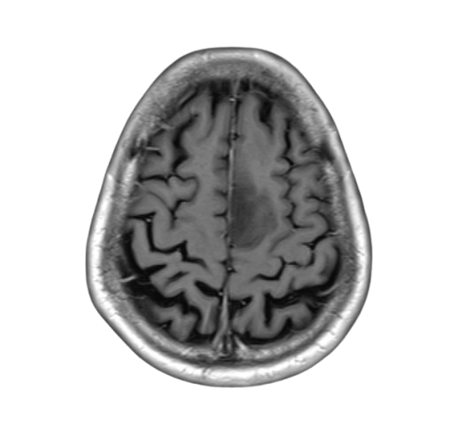
DATA SELECTION
Brain Tumor MRI Images 44 Classes
collection of T1, contrast-enhanced T1, and T2 magnetic
Images without any type of marking or patient identification,
interpreted by radiologists and provided for study purposes.
The images are separated by astrocytoma, carcinoma, ependymoma,
ganglioglioma, germinoma, glioblastoma, granuloma, medulloblastoma,
meningioma, neurocytoma, oligodendroglioma, papilloma, schwannoma
and tuberculoma.
Artificial intelligence in neuro-oncology: advances and challenges in brain tumor diagnosis, prognosis, and precision treatment
Page 04

Slide 5
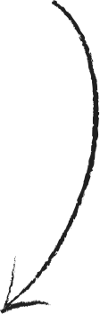
CNN Model From Scratch
ResNet Pretrained Model
CLASSIFICATION
EffiecentNet Pretrained Model
DenseNet Pretrained Model
Page 05

Slide 6
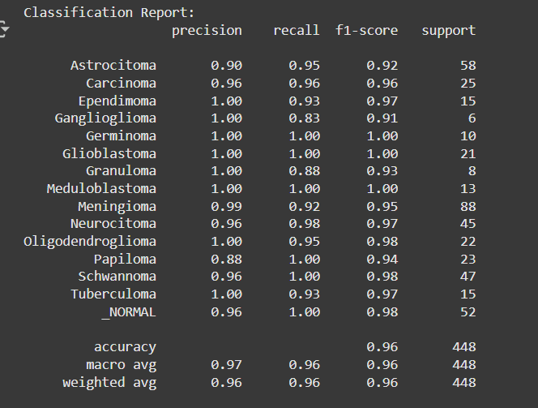
CNN Model
FROM SCRATCH
Built a deep CNN model from scratch with 4 convolutional blocks, dropout, and batch normalization to classify brain tumor MRI images.
Used Adamax optimizer, categorical_crossentropy loss, and callbacks (EarlyStopping, ReduceLROnPlateau) for stable and efficient training.
We tried using pretrained Models
for better performane
Page 06

Slide 7
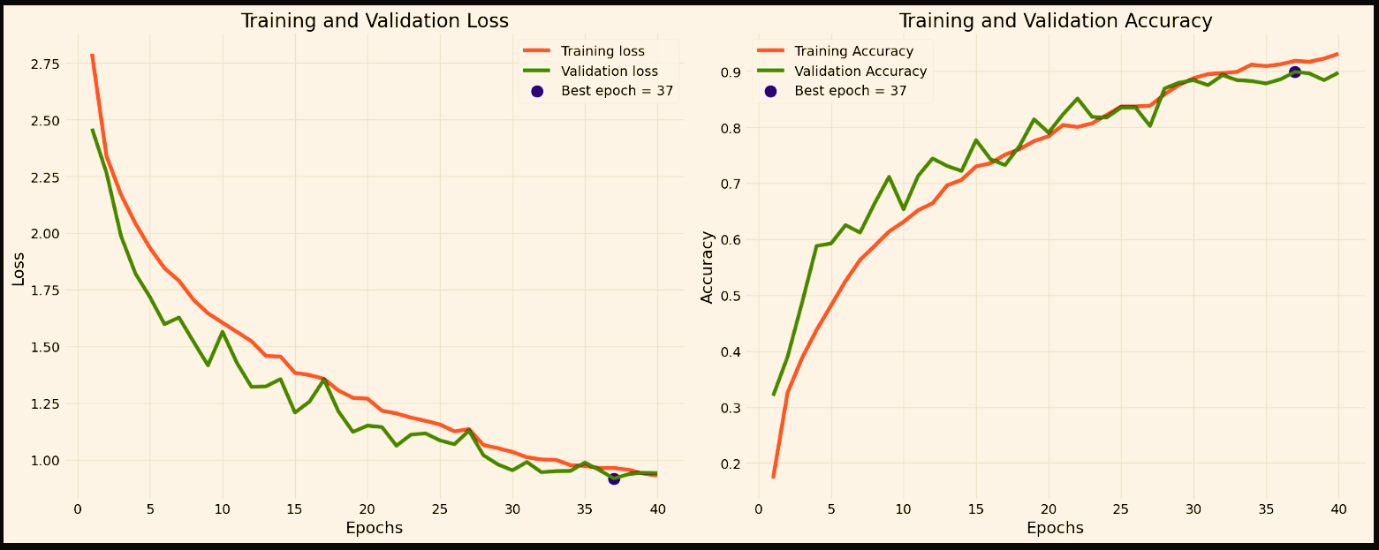

ResNet
PRETRAINED MODEL
Explored various versions of the ResNet architecture to identify the most effective one for our classification task.
After testing and fine-tuning models like , ResNet50, and ResNet101... etc.
ResNet50V2 stood out by delivering the best accuracy and overall best performance of resnet versions
Still not the best Performance Metrics
So we tried Another pretrained Model
Page 07

Slide 8
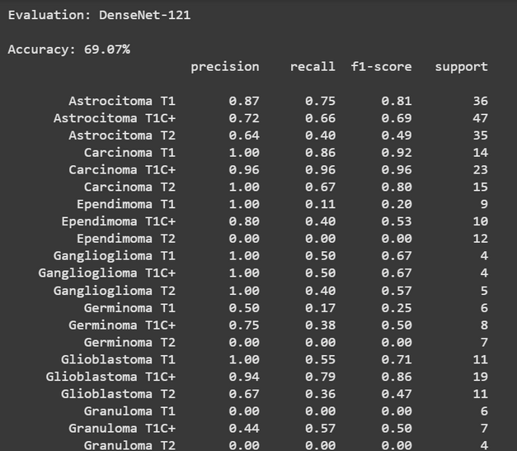

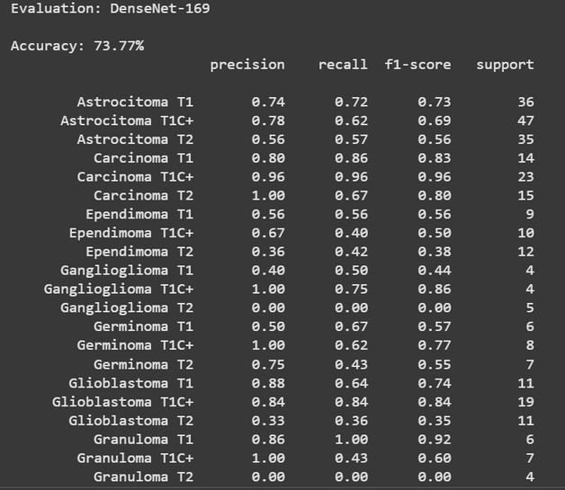
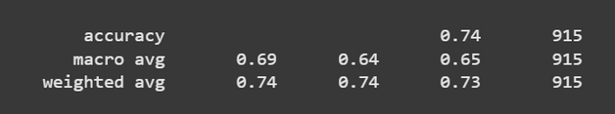
DenseNet
PRETRAINED MODEL
Next, we employed the DenseNet121 & DenseNet169 architecture, leveraging its pre-trained weights on ImageNet. We fine tuned the model to adapt it to our specific classification task.
DenseNet121's design, characterized by dense connections between layers, facilitated efficient feature propagation and reuse, leading to improved performance.
Throughout training, we monitored the model's performance using accuracy and loss metrics, ensuring optimal convergence and generalization
Still not the best Performance Metrics
So we tried Another pretrained Model
Page 08

Slide 9
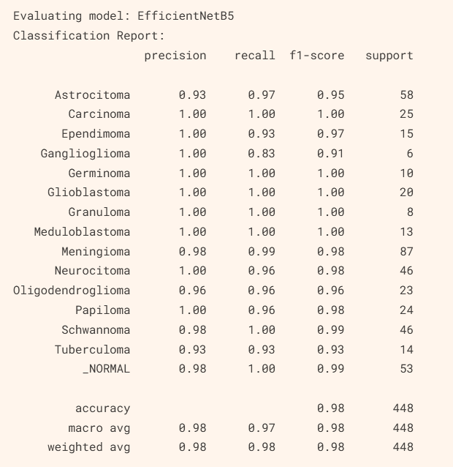
EffiecentNet
PRETRAINED MODEL
Applied the EfficientNet versions to leverage its optimized scaling capabilities for image classification.
After evaluating different variants, EfficientNetB5 was selected as the final model due to its excellent balance of accuracy and computational efficiency, achieving the best results among the tested versions.
Best Performance Metrics
Approved
Page 09

Slide 10
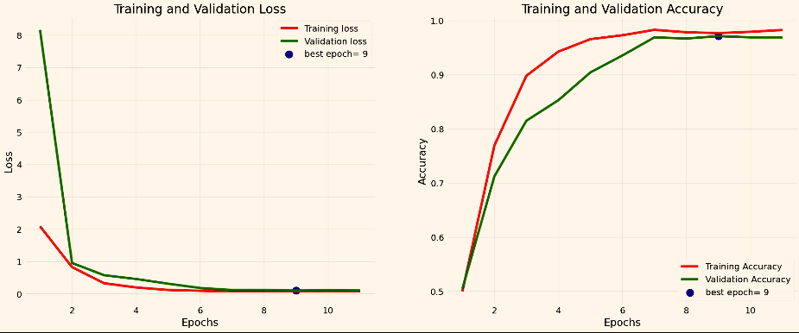
Page 10

Slide 11
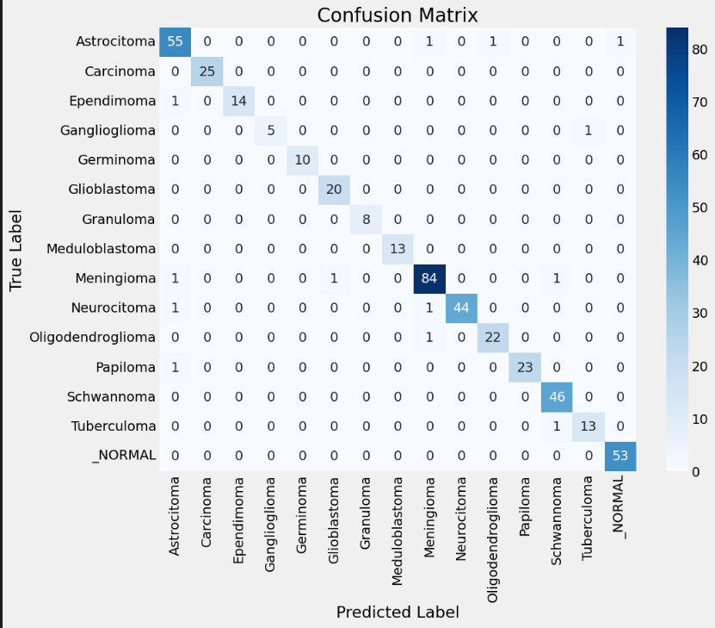

Slide 12
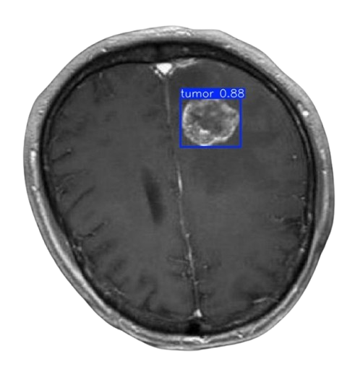
OBJECT DETECTION
Developed a deep learning-based object detection model to automatically detect and classify brain tumors from medical images using the YOLOv8 architecture.
The goal is to assist radiologists and medical practitioners by providing fast and accurate detection to support early diagnosis and treatment planning
Page 11

Slide 13
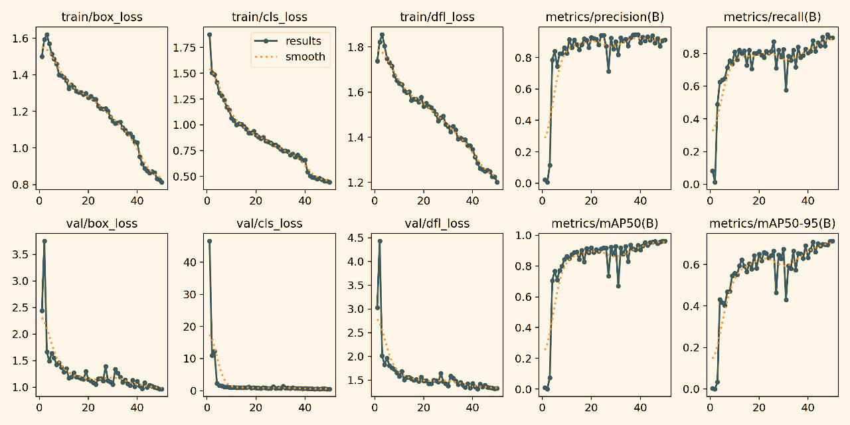

Slide 14
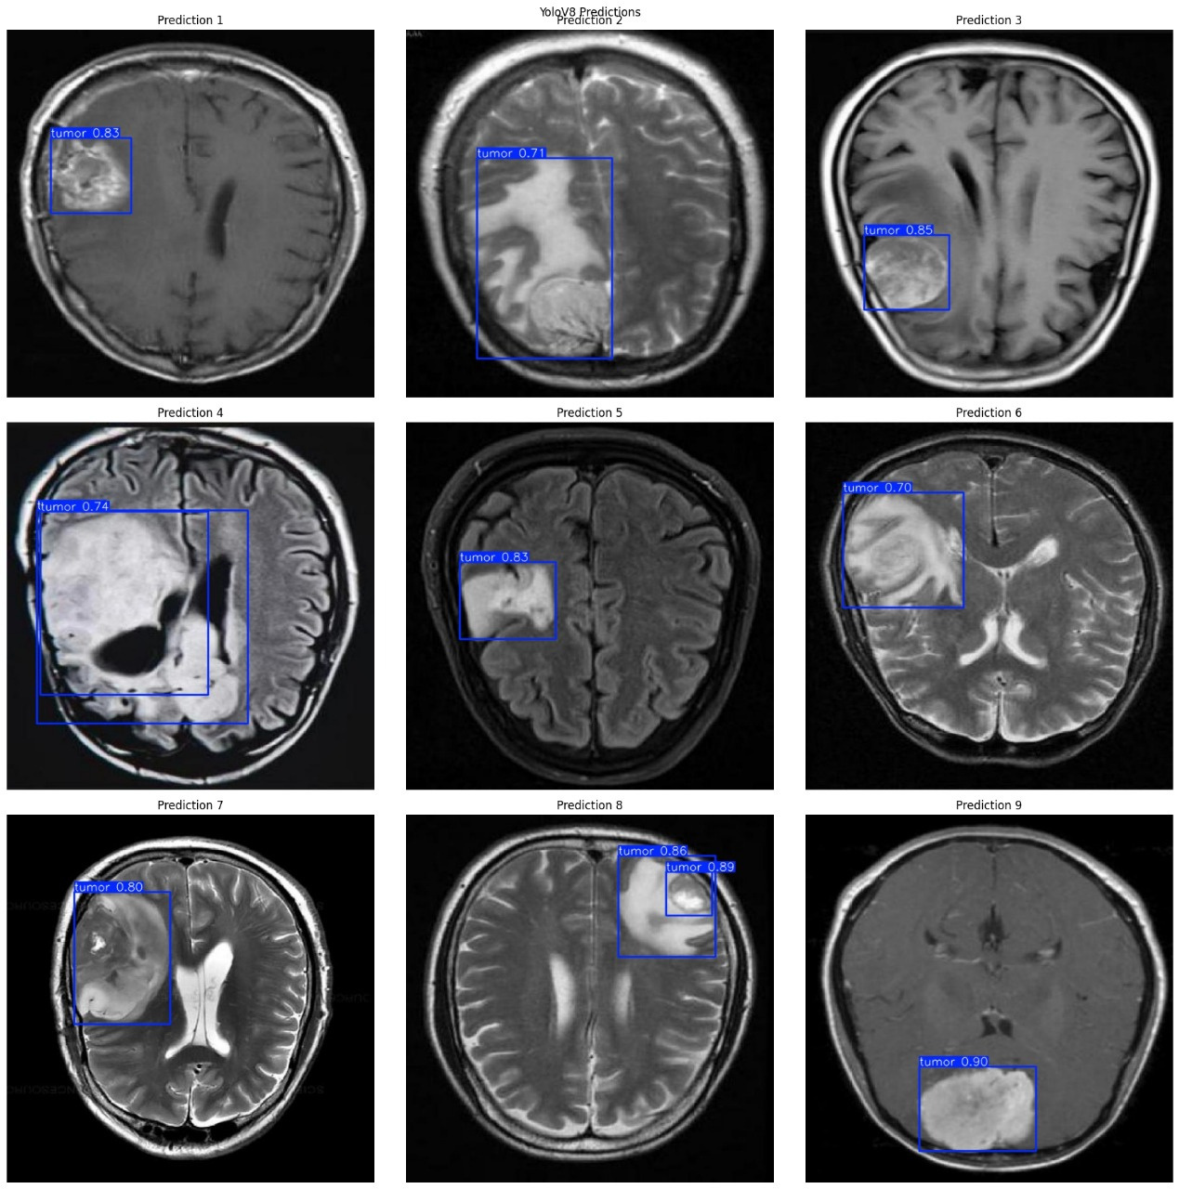

Slide 15
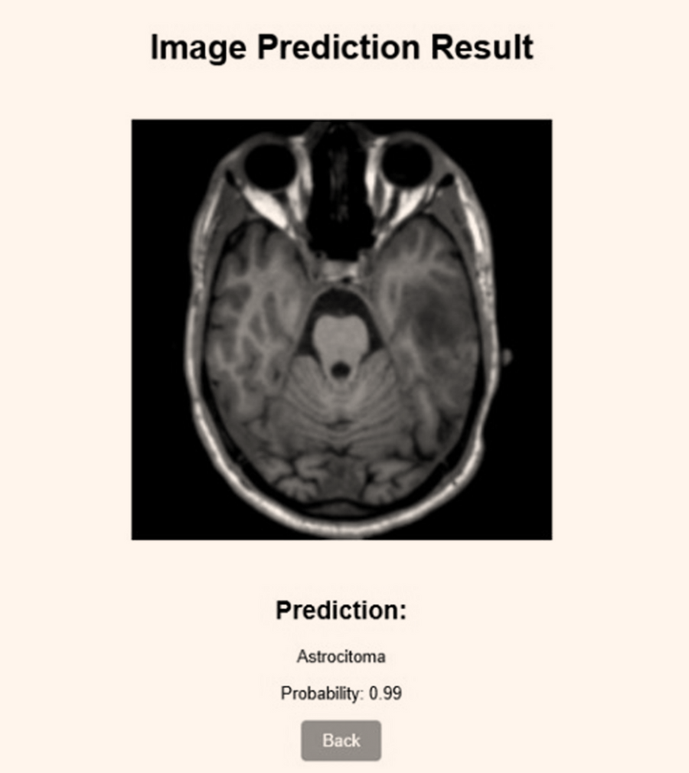
DEPLOYMENT
This Python script is a Flask web application that provides a user interface for classifying brain tumor images using a pre-trained deep learning model based on EfficientNetB5.
The app loads the model, processes uploaded images, performs predictions, and returns the tumor type along with the prediction probability.
Users can upload images via a web interface, where the backend resizes and preprocesses the images before running them through the model.
The prediction results are then displayed on a results page along with the uploaded image, which is encoded in base64 for embedding in the HTML.
Page 14

Slide 16
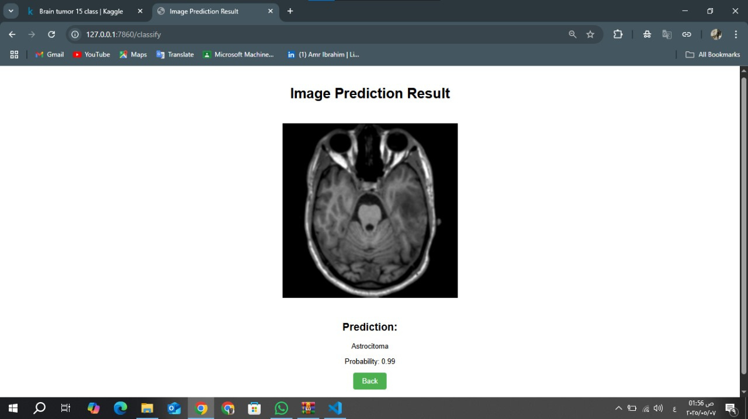

Slide 17

THANK
YOU
Page 16

